Slide 1
Project on Inspecta
Online IDE
(ADVANCE JAVA)

Slide 2
INDEX
Company profile
Brief Overview of Java
Advance java
Servlets
Database Handling
JSP
Hibernate
Project
Conclusion

Slide 3
COMPANY PROFILE
INFOWIZ is leading strategic IT Company offering integrated IT solution.
INFOWIZ is having rich experience managing global clients across various business verticals and align IT strategies to achieve business goals.
INFOWIZ is a 8 years young organization which has won the NATIONAL AWARD for 2 consecutive years 2014-2015 & 2015-16 for BEST Industrial Training from Hon` able GOVERNER of Punjab & Haryana Sh. Kaptan Singh Solanki.
He is also the Chancellor of PTU & Punjabi University. INFOWIZ is a member of Confederation of Indian Industry ( CII membership number – N4654P ) & also with an ISO Certification. We have a global foot prints in providing the off shore companies of US, UK, France, Ireland, Canada and Australia with quality and timely Web and SEO services.

Slide 4
Brief Overview:
JAVA

Slide 5
What is java?
Java is a computer programming language
It is intended to let application developers "write once, run anywhere" (WORA).
Java applications are typically compiled to bytecode (class file) that can run on any Java virtual machine (JVM) regardless of computer architecture.
Java is, as of 2014, one of the most popular programming languages in use, particularly for client-server web applications.
Java is the Internet programming language

Slide 6
Java's History
Java was originally developed by James Gosling at Sun Microsystems (which has since merged into Oracle Corporation).
Originally named OAK in 1991
First non commercial version in 1994
Renamed and modified to Java in 1995 and released as a core component of Sun Microsystems' Java platform.
First Commercial version in late 1995

Slide 7
Java Technology
What is Java?
Java technology is both a programming language and a platform.

Slide 8
The Java Programming Language
The Java programming language is a high-level
language that can be characterized by all of the
following buzzwords:
Object oriented
Multithreaded
Dynamic
secure
Portable
High performance

Slide 9
The Java Platform
A platform is the hardware or software environment in which a program runs. Some of the most popular platforms are Microsoft Windows, Linux, Solaris OS, and Mac OS. Most platforms can be described as a combination of the operating system and underlying hardware.
The Java platform has two components:
The Java Virtual Machine
The Java Application Programming Interface (API)

Slide 10
Different Editions of Java
Java Standard Edition (J2SE)
J2SE can be used to develop client-side standalone applications or applets.
Java Enterprise Edition (J2EE)
J2EE can be used to develop server-side applications such as Java servlets, Java Server Pages,etc.
Java Micro Edition (J2ME).
J2ME can be used to develop applications for mobile devices such as cell phones.

Slide 11


Starting J2EE
JAVA ENTERPRISE EDITION
(J2EE)

Slide 12
Why J2EE?
Simplifies the complexity of a building n-tier application
Standardizes an API between components and application server container
J2EE Application Server and Containers provide the framework services

Slide 13
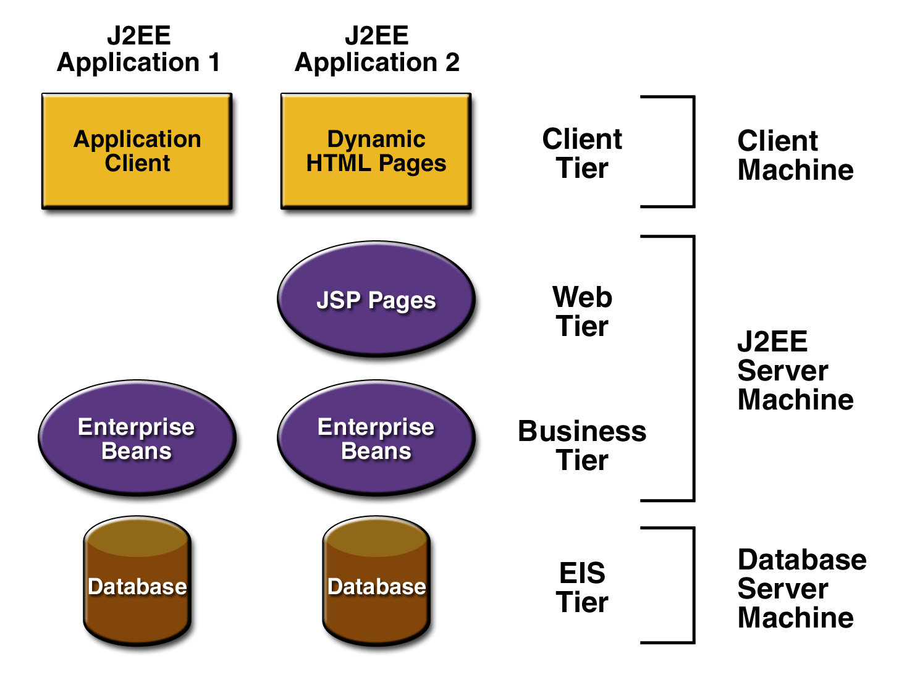
J2EE Tiers
Client Presentation
HTML or Java applets deployed in Browser
XML documentations transmitted through HTTP
Java clients running in Client Java Virtual Machine (JVM)
Presentation Logic
Servlets or JavaServer Pages running in web server
Application Logic
Enterprise JavaBeans running in Server

Slide 14
Servlets

Slide 15
What are Servlets?
The Servlet is a server-side programming language class used for making dynamic web pages. They reside within a servlet engine.
Servlets receive and respond to requests from Web clients, usually across HTTP, the Hypertext Transfer Protocol.
They provide concurrency ,portability and Efficiency.
Notes:
Servlets are invoked through a URL which means that a servlet can be invoked from a browser.
Servlets can be passed parameters via the HTTP request.
Read explicit data sent by client (form data)
• Read implicit data sent by client
(request headers)
• Generate the results
• Send the explicit data back to client (HTML)
• Send the implicit data to client
(status codes and response headers)

Slide 16
Tasks of a Servlet
Read the explicit data sent by the clients (browsers).
Read the implicit HTTP request data sent by the clients (browsers).
Process the data and generate results.
Send the explicit data (i.e.the document) to the clients (browsers).
Send the implicit HTTP response to the clients (browsers).
Notes:
• This includes an HTML form on a Web PAge
• This includes cookies, media types and the browser understands, and so forth.
• This process may require talking to a database, invoking a Web service, or computing the response directly.
This document can be sent in a variety of formats, including text (HTML or XML), binary (GIF images), Excel, etc.
. This includes telling the browsers or other clients what
type of document is being returned (e.g., HTML), setting cookies and caching parameters, and other such tasks.

Slide 17
Servlet life cycle
All methods are performed by Container
Initialize using init() method when requested.
Service() method handles requests/clients. The requests are forwarded to the appropriate method (ie. doGet() or doPost())
Server removes the servlet using destroy() method
Notes:
When a servlet is FIRST requested, it is loaded into the servlet engine.
Once initialization is complete, the request is then forwarded to the appropriate method (ie. doGet or doPost)
The servlet is then held in memory. Subsequent requests are simply forwarded to the servlet object.
When the engine wishes to remove the servlet, its destroy() method is invoked.
NOTE: Servlets can receive multiple requests for multiple clients at any given time. Therefore, servlets must be thread safe

Slide 18
Transfer Of Control
abc.jsp
HTML
Servlet
Abc(java file)
Abc.html

Slide 19
Database Handling
Java database connectivity (JDBC) is a standard application programming interface (API) specification that is implemented by different database vendors to allow Java programs to access their database management systems. The JDBC API consists of a set of interfaces and classes written in the Java programming language.
Basic steps to use database in Java
Establish a connection
Create statements
Execute SQL statements
Get results

Slide 20
Loading drivers
Class.forName("oracle.jdbc.driver.OracleDriver");
Dynamically loads a driver class, for Oracle database.
Making connections
Connection con= DriverManager.getConnection(“Oracle:jdbc:oracle:thin:
@localhost:1521:xc”,”username”,”password”);
Establishes connection to database by obtaining a Connection object .

Slide 21
Specifying SQL queries
Using prepared statements:-
Syntax- PreparedStatement ps= con.preparestatement(“SQL QUERY”);
Execute Query
There are two operations to execute queries:-
Select – ps.executeQuery();
update – ps.executeUpdate();
To store data:-
ResultSet rs= ps.executeQuery();

Slide 22
Java Server Pages
Server-side programming technology that enables the creation of dynamic. Released in 1999 by Sun Microsystems.
Platform-independent method for building Web-based applications.
Uses static data usually HTML.
To deploy and run JavaServer Pages, a compatible web server with a servlet container, such as Apache Tomcat is required.
Entire JSP page gets translated into a servlet (once), and servlet gets invoked (for each request)
JavaServer Pages (JSP) lets you separate the dynamic part of your pages from the static HTML.
HTML tags and text
<% some JSP code here %>
HTML tags and text

Slide 23


Working of JSP…
server send the .JSP
file to JSP
servlet engine
Java Engine
loads the JSP page from disk and converts it into a servlet content.
HTTP Request
Client
Static HTML content
.class
Server with JSP Container
dynamically generated HTML page inside the HTTP response
loads the Servlet class and executes it. Server produces an o/p in HTTP format during exc.
Servlet Engine
Notes:
JSP engine This conversion is very simple in which all template text is converted to println( ) statements and all JSP elements are converted to Java code that implements the corresponding dynamic behavior of the page. JSP engine compiles the servlet into an executable class and forwards the original request to a servlet engine. A part of the web server called the servlet engine loads the Servlet class and executes it. During execution, the servlet produces an output in HTML format, which the servlet engine passes to the web server inside an HTTP response.
The web server forwards the HTTP response to your browser in terms of static HTML content.
Finally web browser handles the dynamically generated HTML page inside the HTTP response exactly as if it were a static page.
The JSP engine compiles the servlet into an executable class and forwards the original request to a servlet engin

Slide 24
JSP v/s Servlets
Servlets are strictly written in Java .
Servlets must be given both a servlet definition and one or more mappings within the web deployment descriptor (web.xml).
Servlets are for generic handling of an HTTP request.
Executed as a servlet itself
JSPs contain mixed dynamic content.
JSPs do not require either, allowing much quicker and less brittle page creation.
JSPs are specifically targeted and optimized to render a response to the request in the output language of choice (typically HTML).
Code is compiled into a servlet
Notes:
.

Slide 25
What is Struts ?
Frameworks(Front-Ends) for Developing Java web based applications
free open-source
Current Version: 1.1
Based on architecture of MVC(Model-View-Controller) Design Pattern

Slide 26
Why Struts?
Flexible, extensible and structured front-ends
Large user community
Stable Framework
Open source
Easy to learn and use
Feature-rich( like error handling and MVC )
Works with existing web apps

Slide 27
Web Xml File
web.xml includes:
– Configure ActionServlet instance and mapping
– Resource file as <init-param>
– servlet-config.xml file as <init-param>
– Define the Struts tag libraries
web.xml is stored in WEB-INF/web.xml

Slide 28
Example: web.xml
<servlet>
<servlet-name>action</servlet-name>
<servlet-class>
org.apache.struts.action.ActionServlet
</servlet-class>
<init-param>
<param-name>config</param-name>
<param-value>/WEB-INF/struts- config.xml</param value>
</init-param>
</servlet>

Slide 29
Hibernate: An Introduction
It is an object-relational mapping (ORM) solution for Java
We make our data persistent by storing it in a database
Hibernate takes care of this for us

Slide 30
Object-Relational Mapping
It is a programming technique for converting object-type data of an object oriented programming language into database tables.
Hibernate is used convert object data in JAVA to relational database tables.

Slide 31
Why Hibernate and not JDBC?
JDBC maps Java classes to database tables (and from Java data types to SQL data types)
Hibernate automatically generates the SQL queries.
Hibernate provides data query and retrieval facilities and can significantly reduce development time otherwise spent with manual data handling in SQL and JDBC.
Makes an application portable to all SQL databases.

Slide 32
Hibernate vs. JDBC (an example)
JDBC tuple insertion –
st.executeUpdate(“INSERT INTO book VALUES(“Harry Potter”,”J.K.Rowling”));
Hibernate tuple insertion –
session.save(book1);

Slide 33
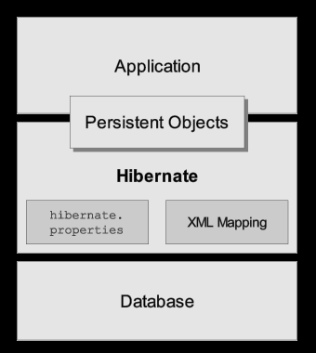
Architecture
Hibernate sits between your code and the database
Maps persistent objects to tables in the database

Slide 34
project

Slide 35
requirement's
Software Requirement:
Operating System : Windows 2010
Languages : Java
Frontend : HTML, JavaScript, JSE
Platform : J2EE
Web Servers : Apache Tomcat 5.0
Backend : My SQL workbench 6.3
Browser Program : IE/Mozilla Fireworks
Scripting : JSP

Slide 36
PROJECT EXECUTION

Slide 37
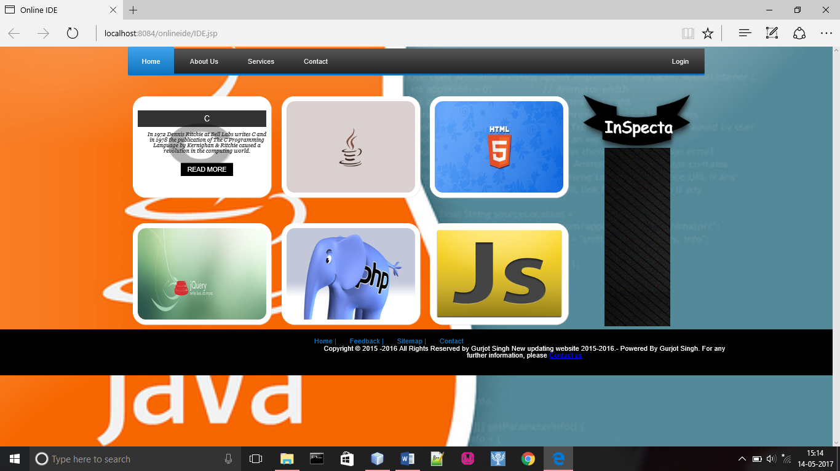

Slide 38
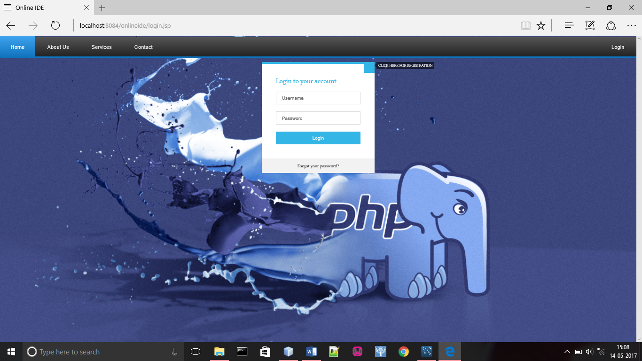

Slide 39
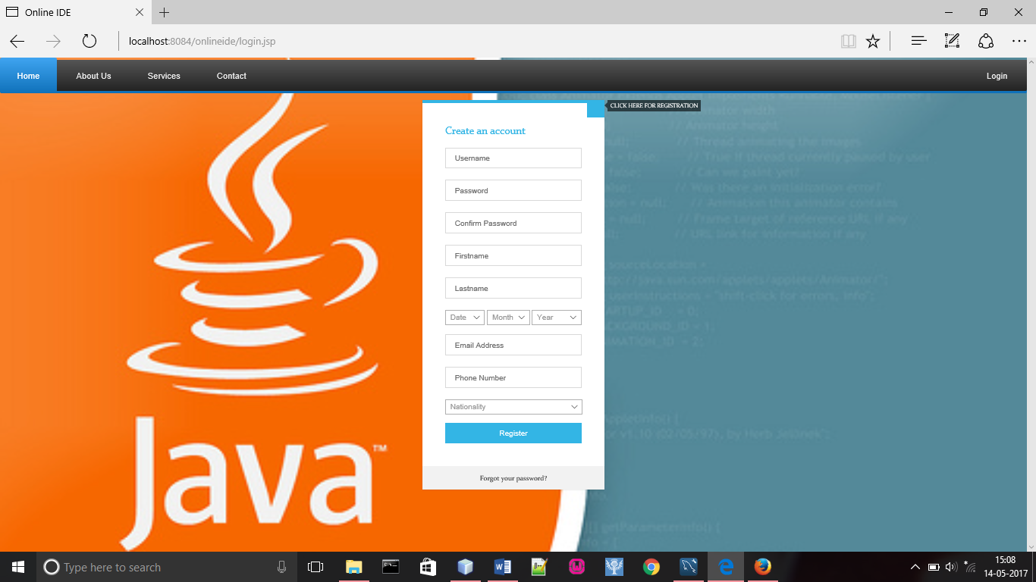

Slide 40
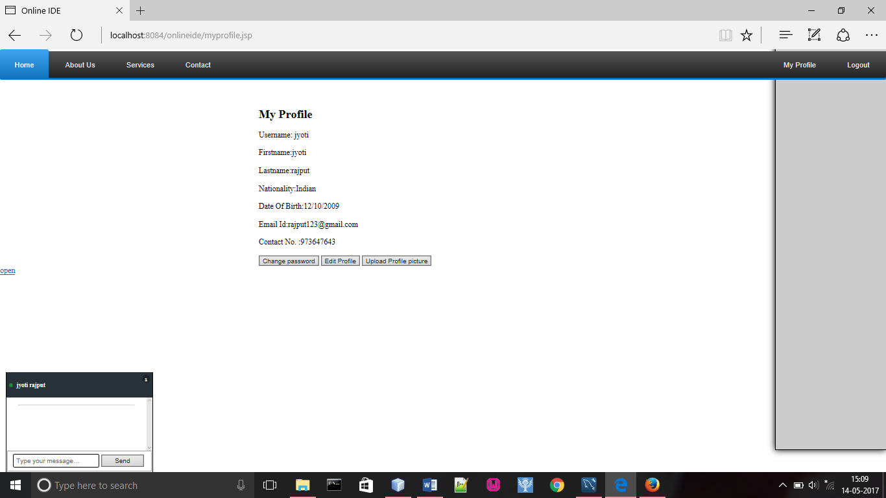

Slide 41
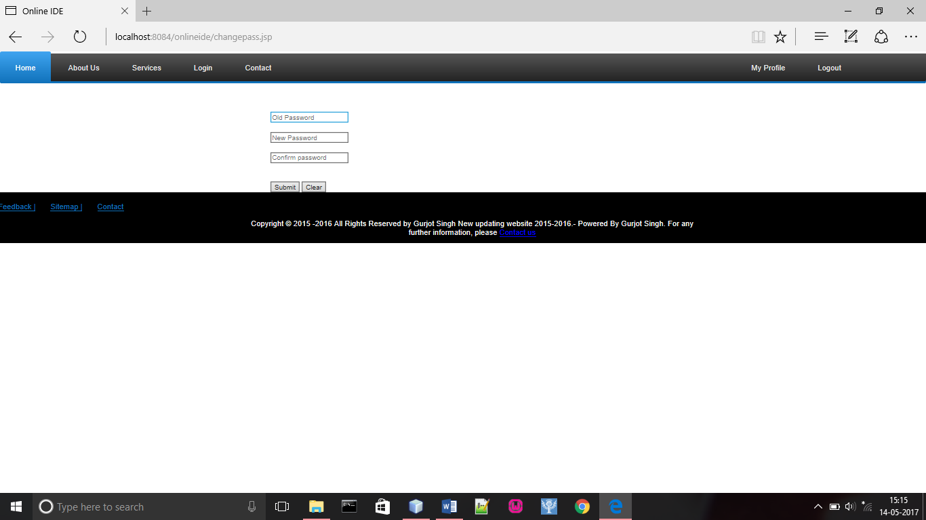

Slide 42
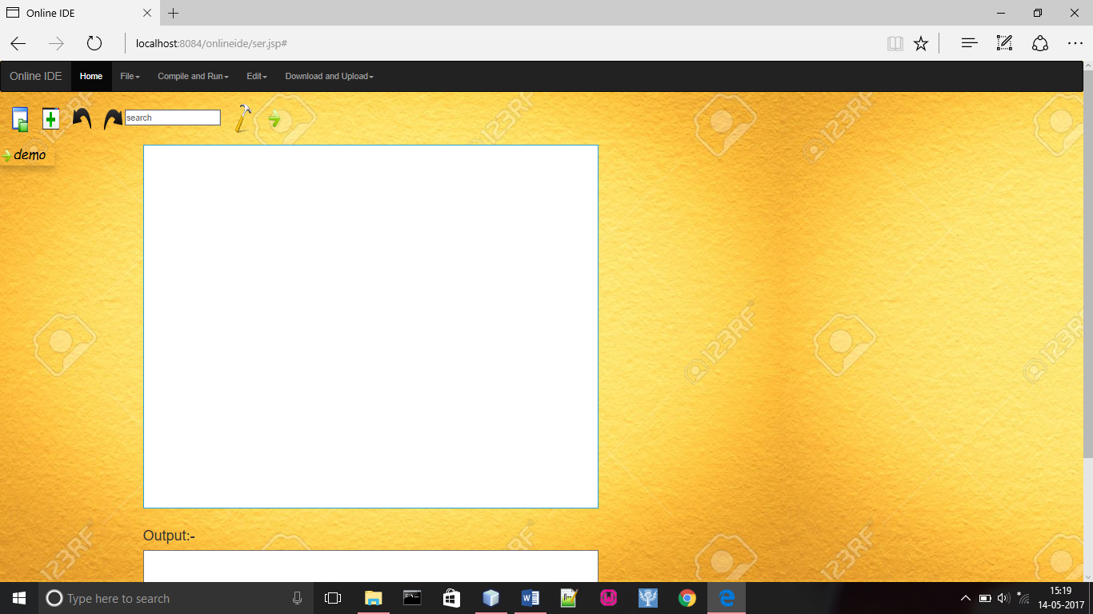

Slide 43
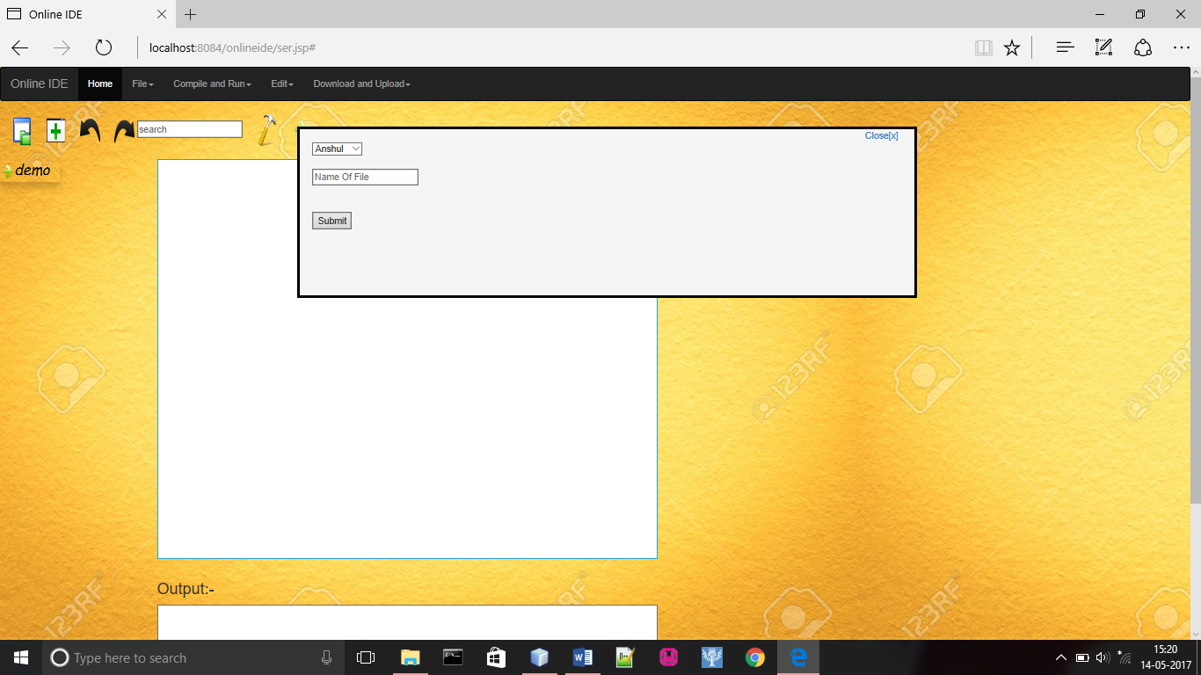

Slide 44
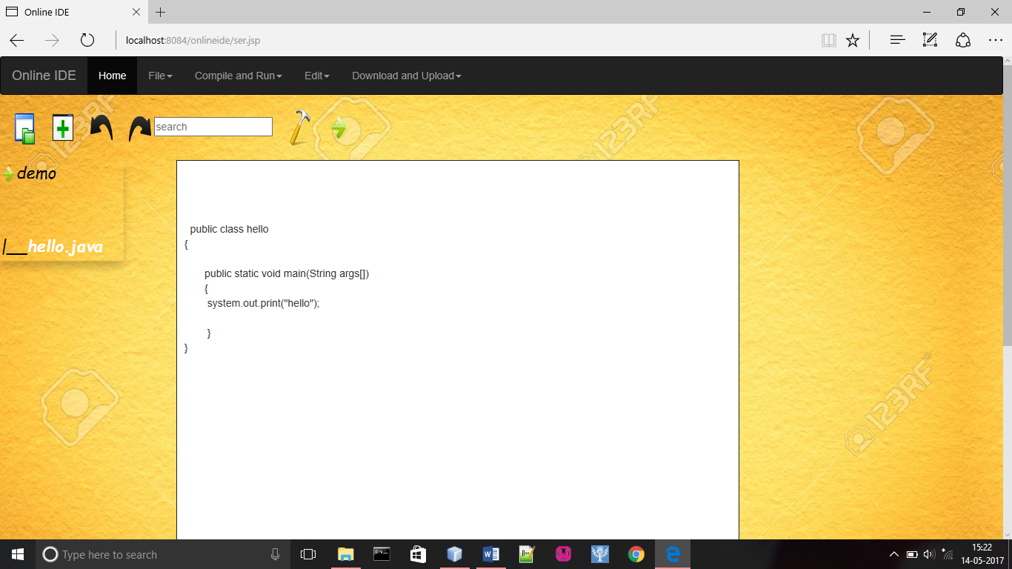

Slide 45
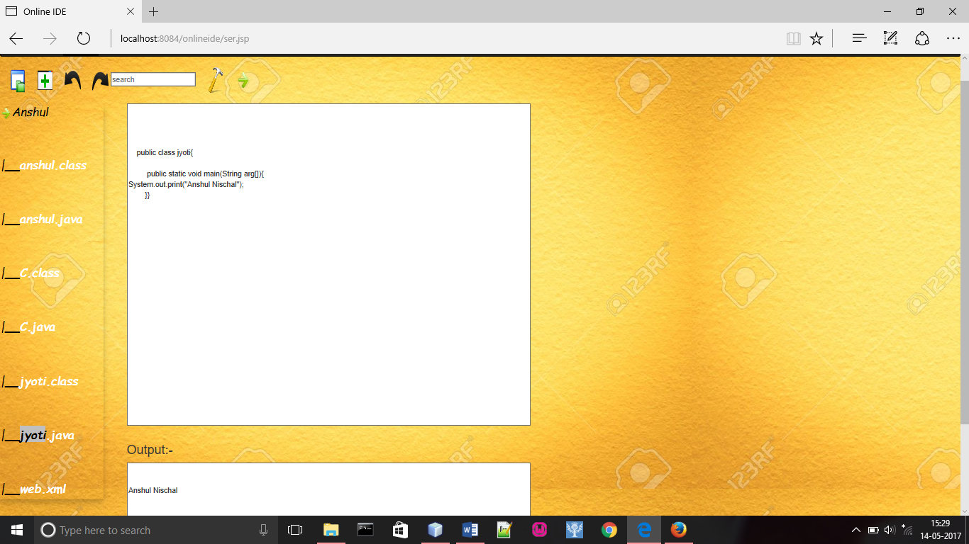

Slide 46
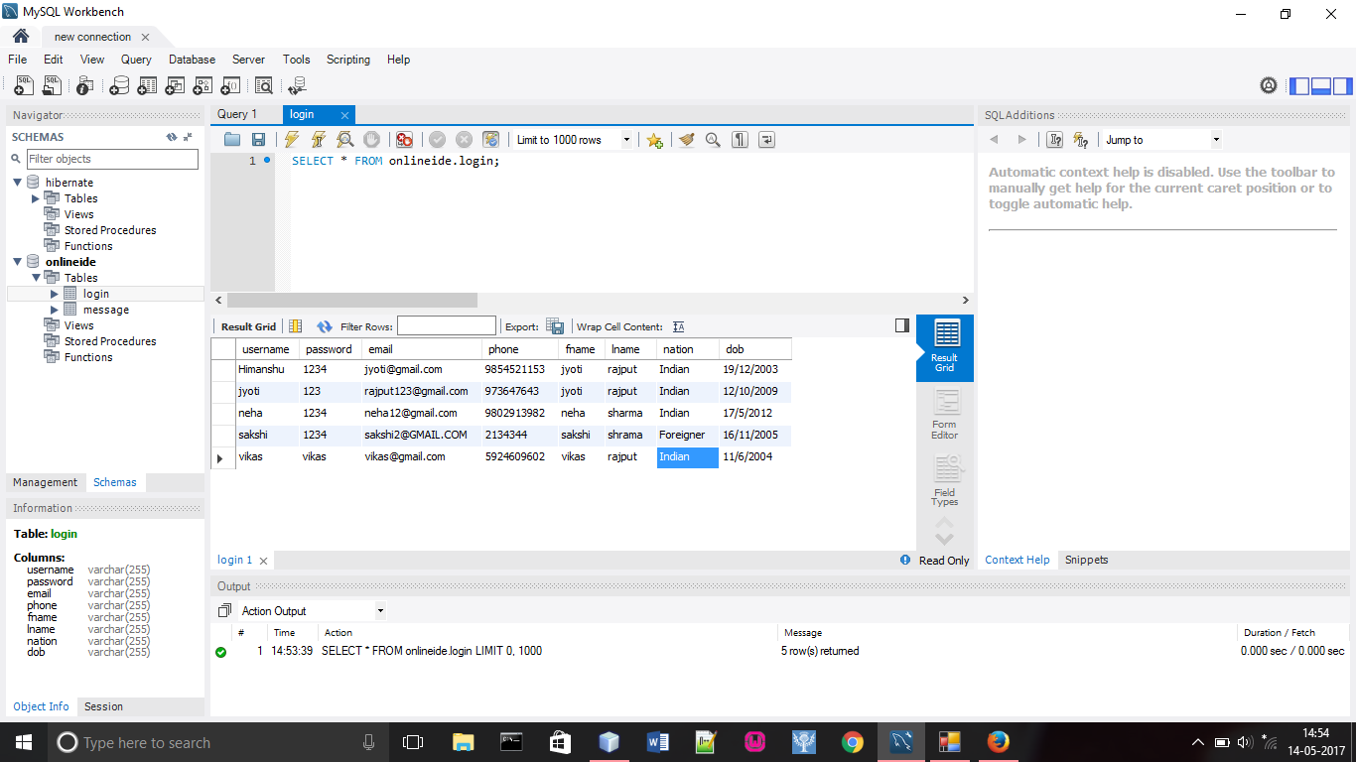

Slide 47
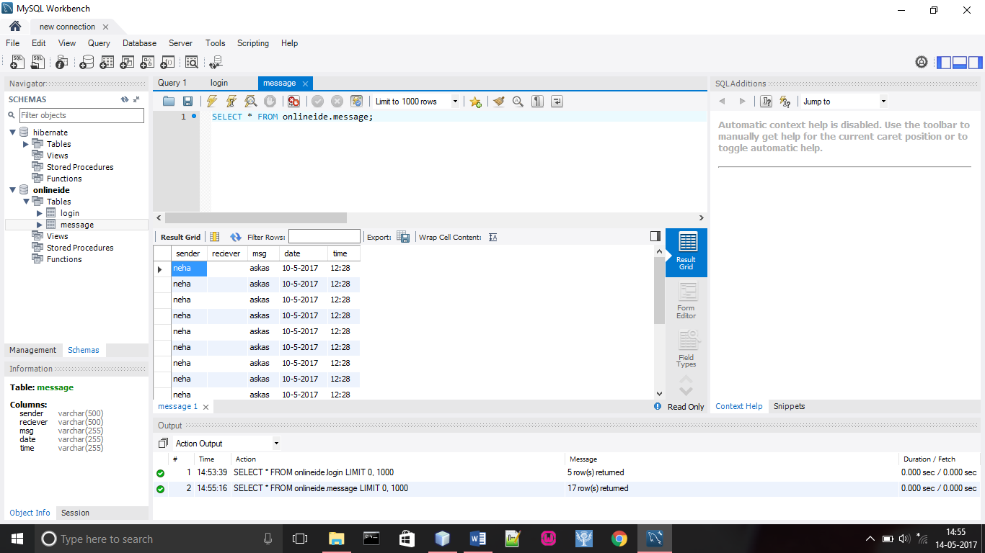

Slide 48
CONCLUSION
INSPECTA ONLINE IDE is a web application providing various technical resources. This is a portal where the visitors can access various resources at one place.
Features of All modules are provided to perform different functions separately.

Slide 49
Continue……
Login module is used to develop high security because this online ide is logged in after registration and making profile
Profile composed of all details of adding data ,changing password and editing profile .
Services module provides creation Of new project., with new file ,share ,download, upload ,compilation ,execution of project and etc. many more features.

Slide 50
Continue……
ADVANTEGES OF PROJECT:
It is fast, simple, cost efficient and reliable.
Reduce manual work by saving file in service module.
Avoids data redundancy and inconsistency.
Very user-friendly.
Easy accessibility of data.
Provides more security and integrity to data.

Slide 51
THANK U

